Slide 1
Web Security 3
devgianlu • 22/05/2024

Slide 2
On the client-side…
XSS
CSRF

Slide 3
Client side:
XSS

Slide 4
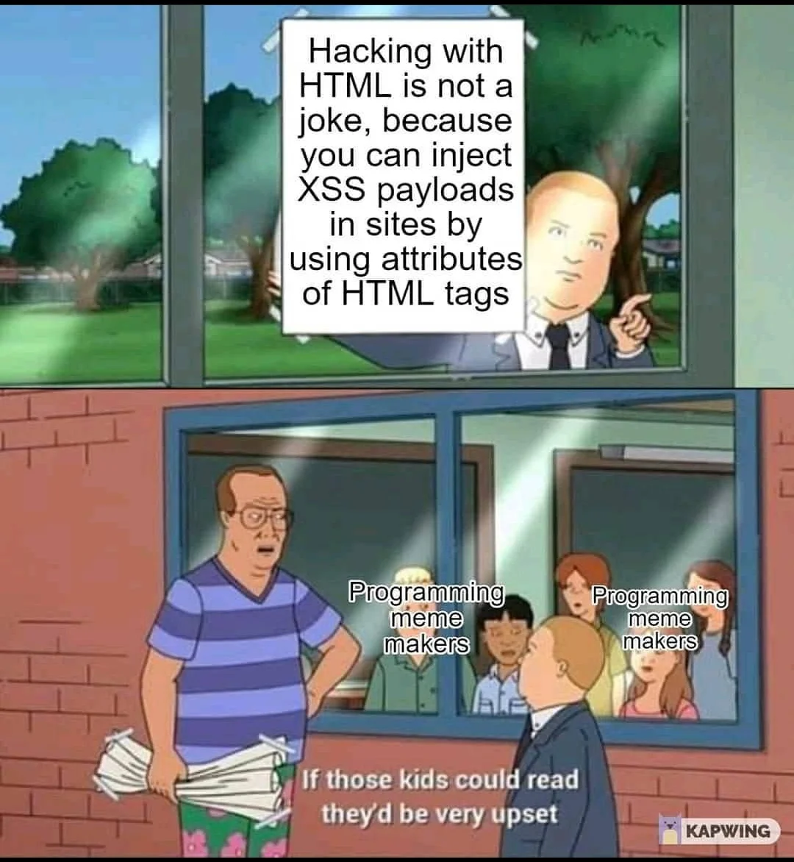
HTML 🤝 JavaScript
HTML and JavaScript are the founding blocks of any modern page on the Internet. Because of this we should have a good knowledge of them to exploit client-side vulnerabilities.
Some gotchas:
HTML is made of tags
Tags can have attributes and children (more tags)
JavaScript runs with script tags
JavaScript can access the DOM (HTML page)
JavaScript can make HTTP requests
JavaScript is very powerful
As previously stated, MDN is a great resource:
HTML
JavaScript

Slide 5
Possible attack vectors
Web pages contain lots of sensitive/private information, think of home banking, webmail or any other authenticated website really.
We know JS can make HTTP requests… So what if I make a request to the banking website from my evil site? Clearly that shouldn’t work!
Where should we break the chain?
evil.com loads a JS script
evil.com makes a request to bank.com
The browser adds cookies for bank.com to the request
bank.com responds to the request
evil.com reads the response from bank.com
You’re fucked…

Slide 6
SOP to the rescue
Introducing the almighty Same-origin Policy!
SOP prevents a website from accessing another website without the explicit consent of said website (Access-Control-Allow-Origin). Some exceptions are allowed, for example: embedding scripts, images, CSS styles or iframes (details below).
These rules are enforced for browser APIs too: you cannot access the content (contentWindow) of an iframe that has a different origin from the parent.
The “origin” is composed by protocol, host and port, so:
https://evil.com != https://bank.com
https://example.com:80 != https://example.com:8080
http://example.com != https://example.com
More on SOP

Slide 7
Not just SOP
Another commonly used policy on websites to mitigate more and more XSS is the Content Security Policy.
The Content-Security-Policy header (returned by the server) can be used to limit what resources can be loaded on a page.
Some examples:
Prevent loading of any resource that is outside the origin (includes images, scripts, etc):
Content-Security-Policy: default-src 'self'
Allow loading images from anywhere, but prevent anything other that is outside the origin:
Content-Security-Policy: default-src 'self'; img-src *
The CSP can also be configured to send reports of violations to a particular endpoint!
More on CSP

Slide 8
JavaScript injections
We have seen many injections, let’s see another one. Injecting JavaScript code inside a browser page allows us to do many things: from stealing cookies to click hijacking. We call this Cross-Site Scripting (XSS) because, indeed, we are executing a script on another website.
There are mainly two types of XSS:
Reflected: some part of the HTTP request (query, body, etc) is “reflected” in the HTML page without sanitization and allows injecting some HTML. They are the most common and usually less powerful. You would need the victim to visit that specially crafted URL to trigger the payload.
Stored: the payload is stored somewhere in the website (through a database or a file) and the victim may visit the malicious page without knowing at all that the page is being used against him. These are the most powerful because possibly allow attacking the entire user base without them knowing.
XSS are not difficult to prevent: you should never allow anything in the page without proper HTML escaping. Server side templates (mind SSTI lol) are usually safe and if you can’t use them make sure everything is sanitized properly (see DOMPurify for example).

Slide 9
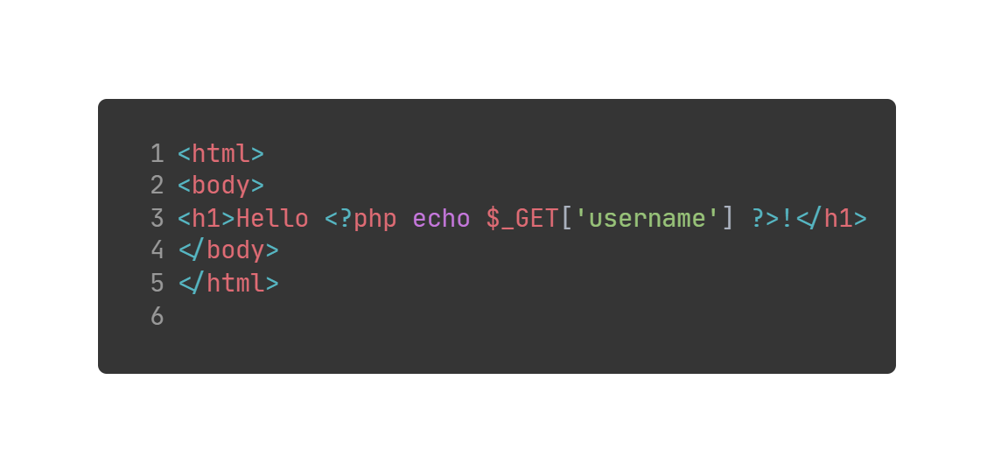
XSS easy AF
Source code

Slide 10
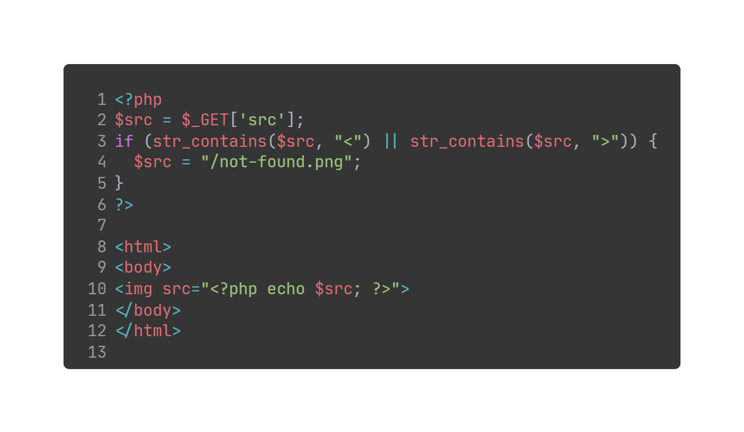
XSS still easy AF
Source code

Slide 11
Client side:
CSRF

Slide 12
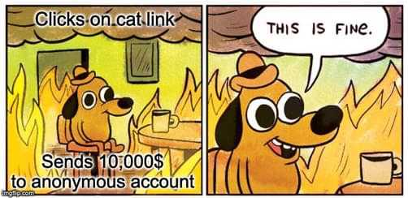
SSRF in your browser
Client-side request forgery is a technique that allows performing malicious requests directly from the victim’s browser.
If you can execute JavaScript code you can probably make requests just like the user would make them (authenticated). On a banking website, for example, an attacker could perform a request to transfer money to another account because the request would come from the website itself.
This methodology completely bypasses SOP or CORS since there is no need to leak cookies or make out of bound requests, but it is not always effective since the scope of the attack might be to exfiltrate data. There are still ways where you could exfiltrate information from the page through the website by placing what you need as a “shared source” that both the victim and the attacker have access to.

Slide 13
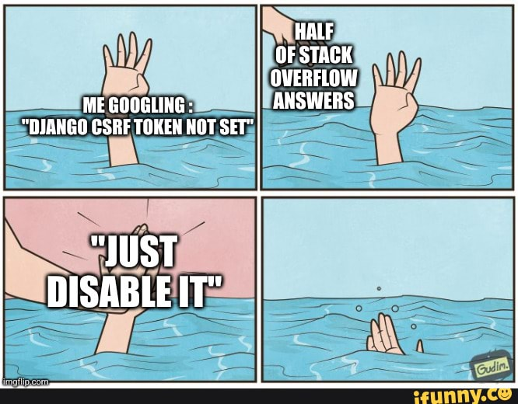
CSRF mitigations
Obviously there are mitigations for these kind of attacks: the so called anti-CSRF tokens. These tokens are generated by the backend and stored in the user session, whenever a page is loaded the token is inserted in the request and the backend checks that user requests contain that exact token or they are rejected. The token should also be random and not predictable.
Some attacks are prevented with this technique, but if the attacker controls the entire JavaScript code being executed it is completely possible to get the CSRF token from the HTML and then submit it with the request.
It could be possible to steal cookies with CSRF if the cookie policy isn’t set properly: remember the SameSite attribute? If set to None, a CSRF allows us to steal it.

